Slide 1
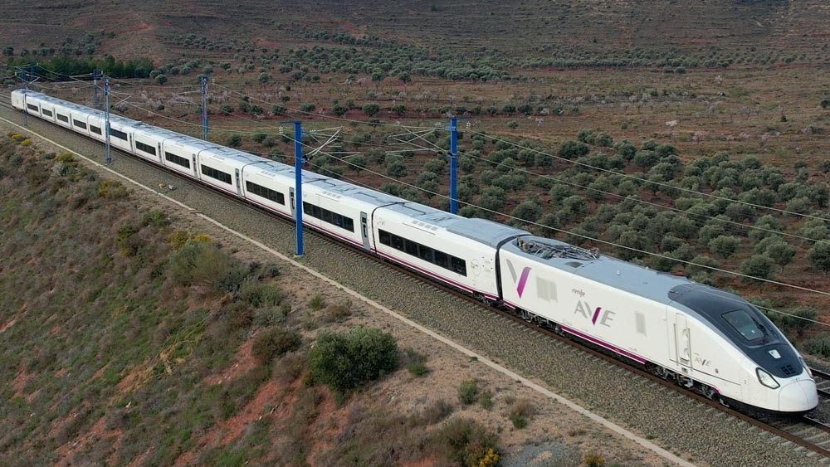
Use of high-speed trains in Spain – insights for Renfe strategy

Slide 2
CONTENT
Introduction
Sample data
Sample analysis
Useful insights

Slide 3
CONTENT
Introduction
Sample data
Sample analysis
Useful insights

Slide 4
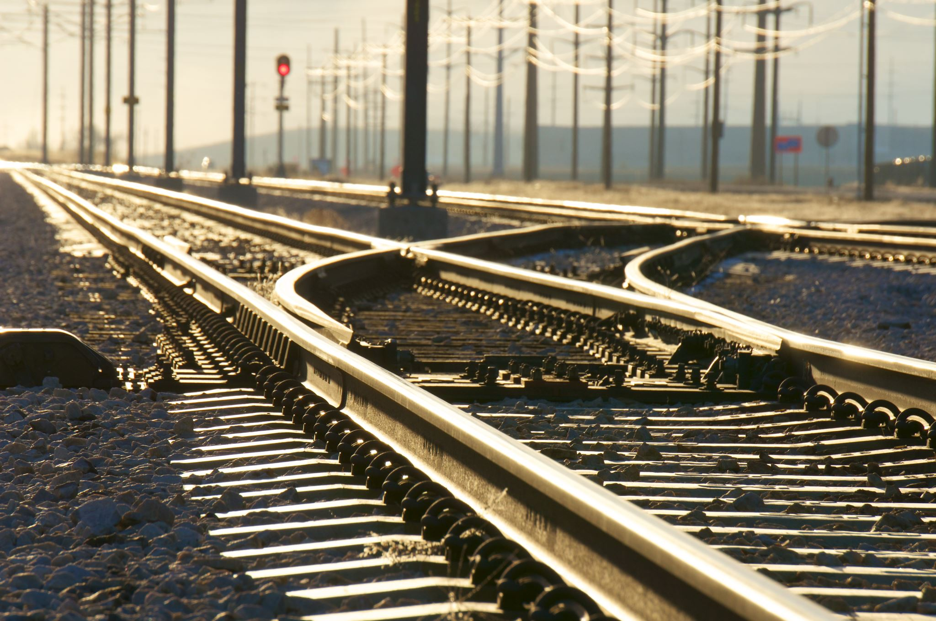


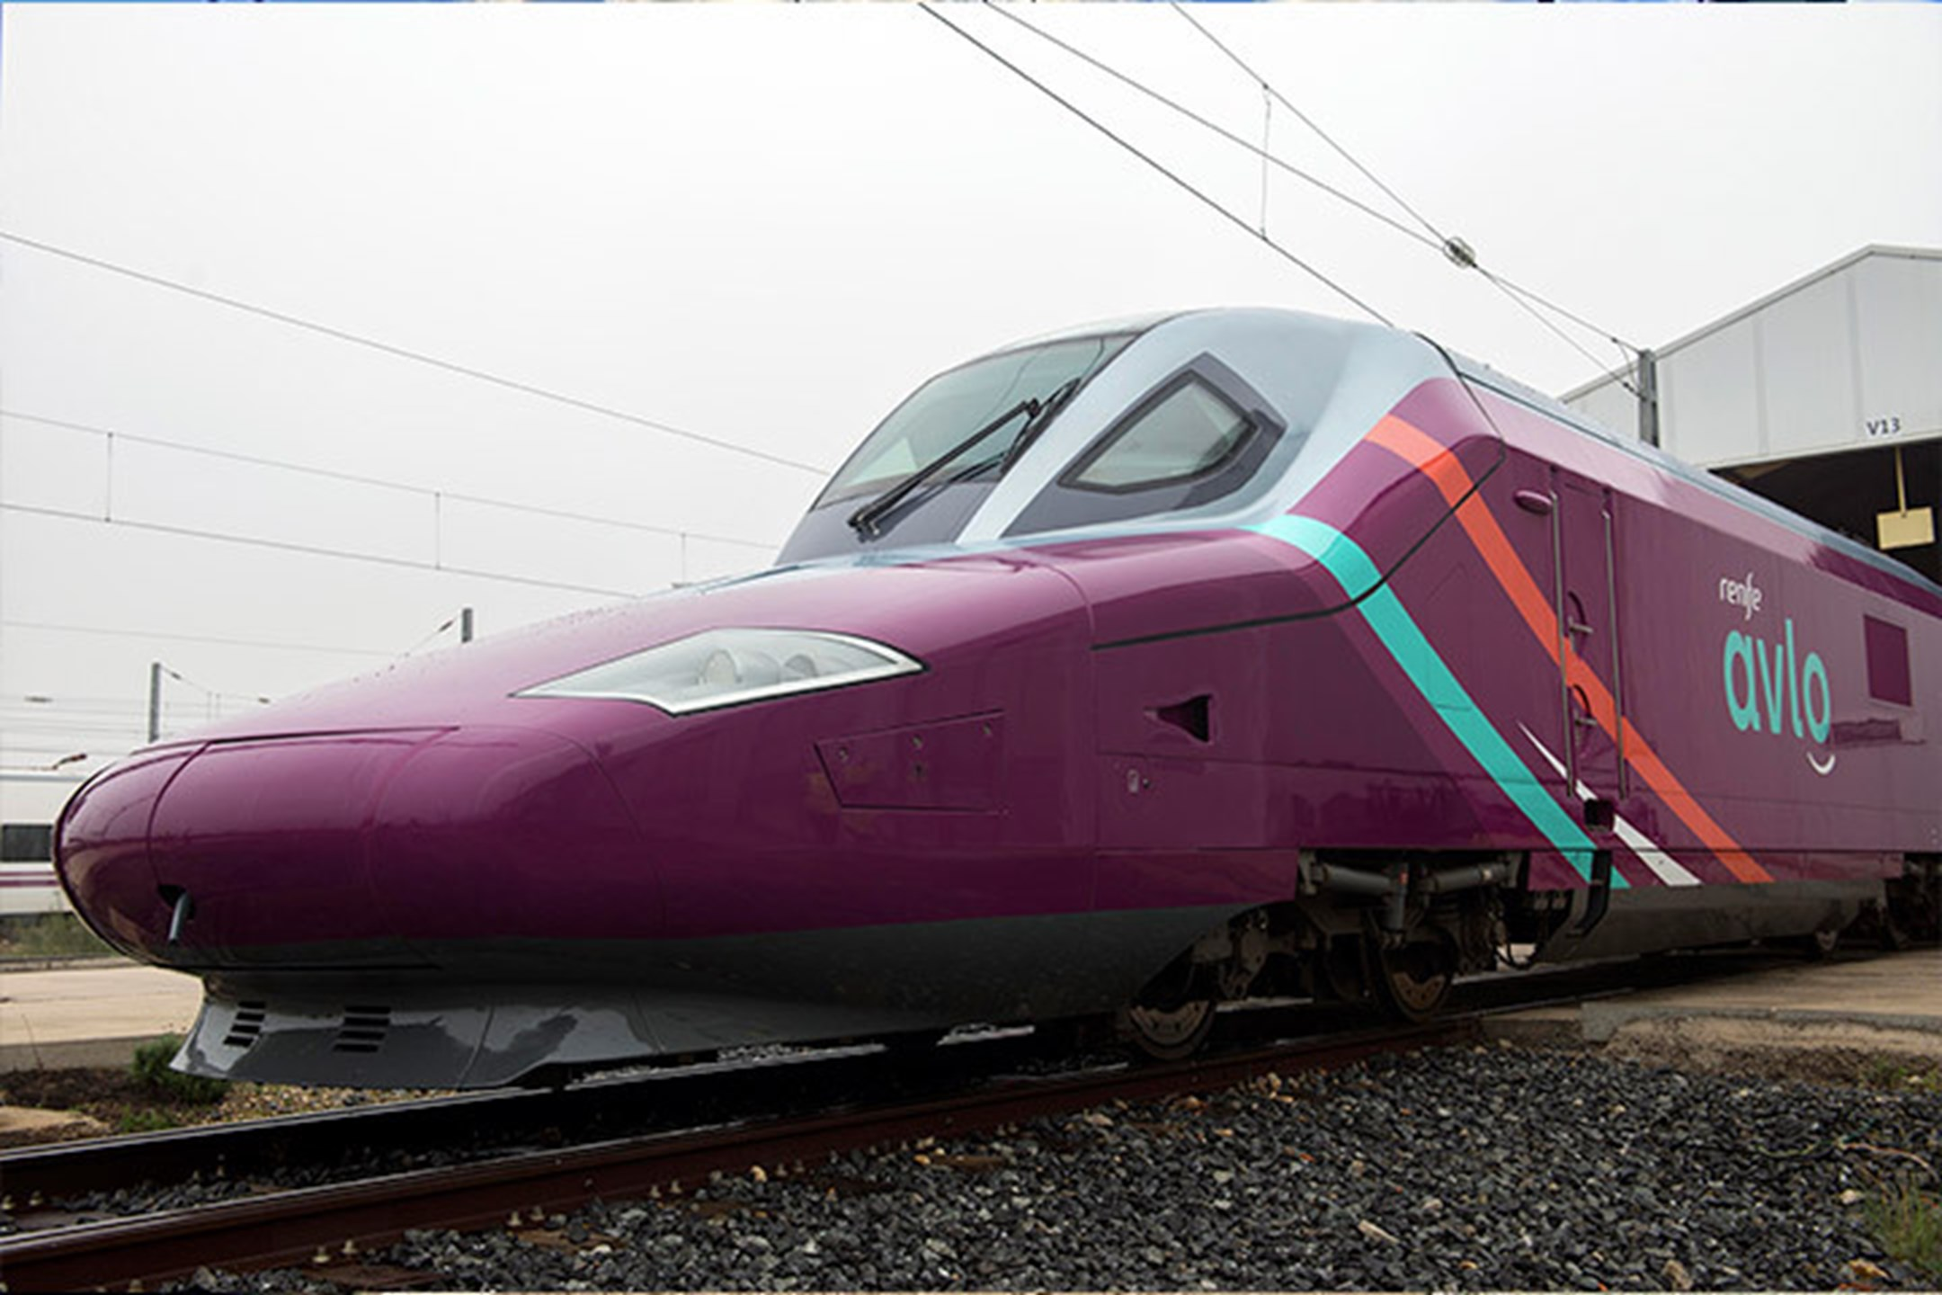
Introduction
New ones from S106 series. Launched on May 2024 able to host up to 500 passengers. Reclining seats, power sockets, free wifi, restaurant and catering services depending on class.
3 suitscases + personal bag. Flexible tickets and modifications allowed on tickets.
Low-cost version launched in May 2024 to compete with new low-cost operators. Basic seats, free Wifi, vending machines (no restaurante). One suit-case per Passenger + personal bag.

Slide 5
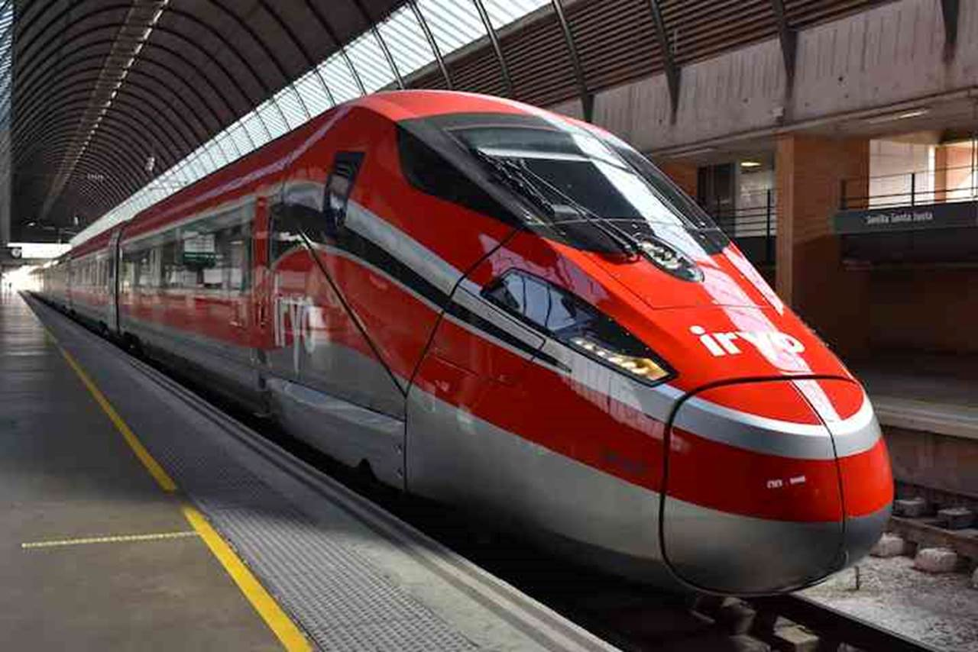
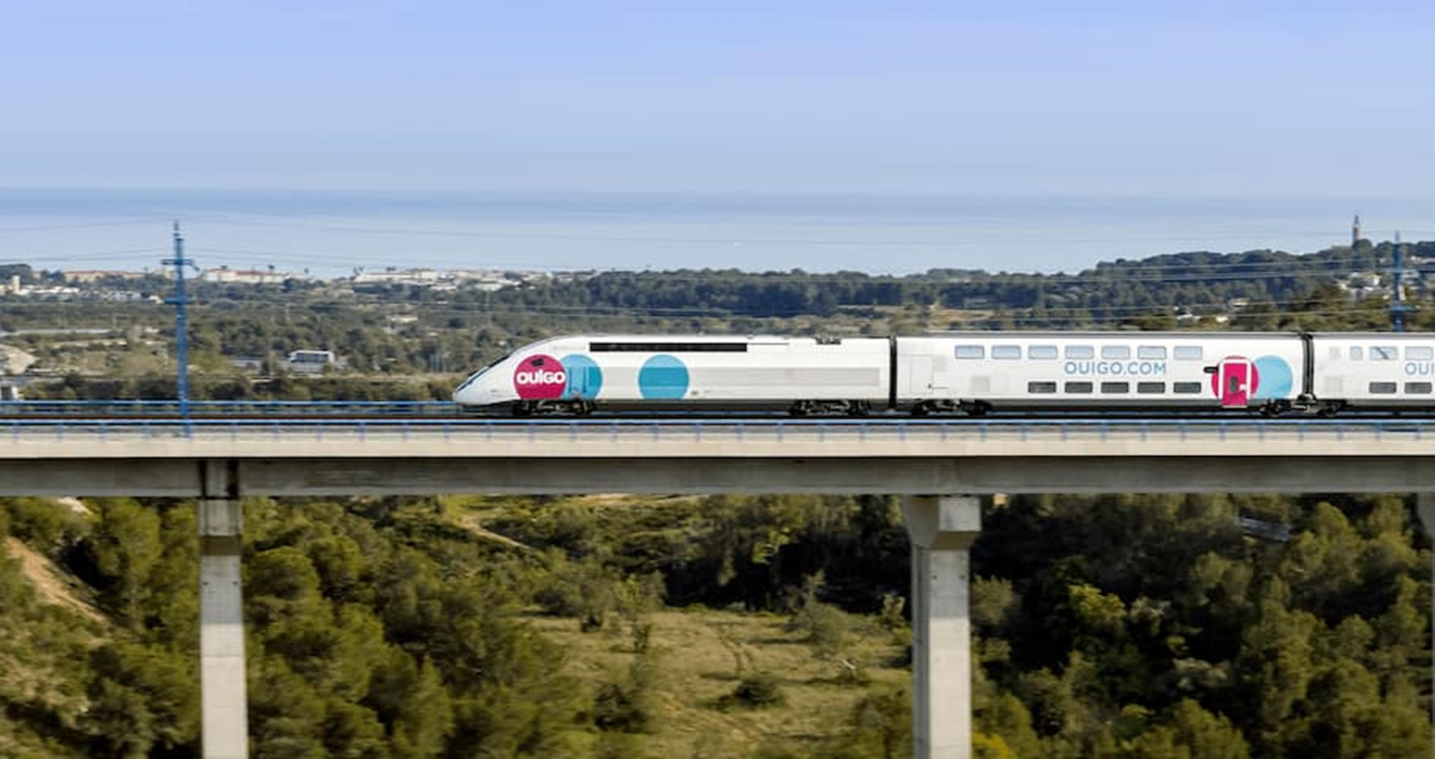
Iryo started on november 2022. Capaity for 420 passengers with different categories too , comfortable seats, free Wi-Fi.
Low-cost version launched in May 2021. It offers OUIBAR, XL seats and Wi-Fi under OUIGO-PLUS

Slide 6
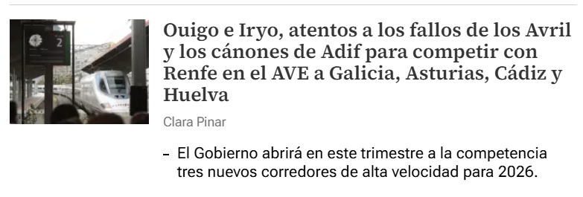
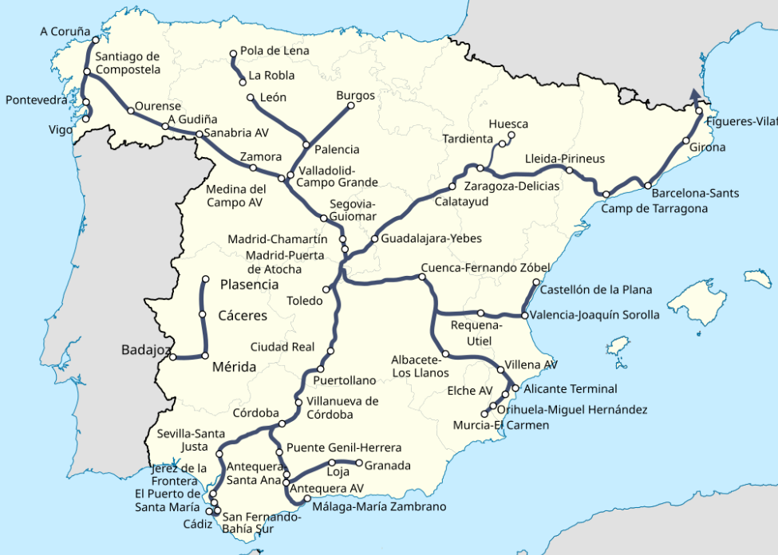
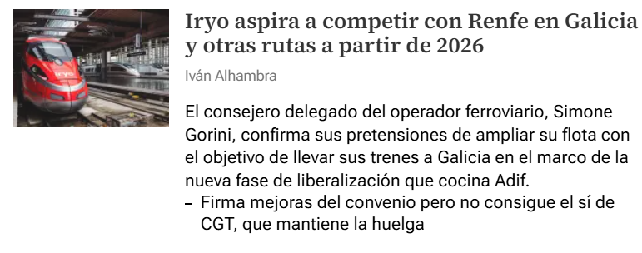


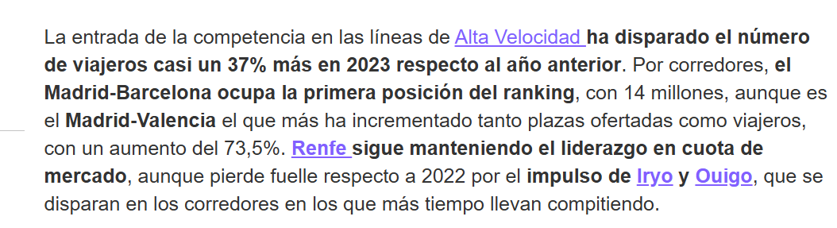
High-speed railways in Spain
Iberian gauge (1668 mm) – 3000V DC
International/standard gauge (1435 mmm) – 25kV AC

Slide 7
 | AVLO | AVE | Iryo | OUIGO
Speed | 300 km/h | 300 km/h | 300 km/h | 330 km/h
Tickets | Basic | Basic Elige Elige Confort Premium | Inicial Singular Singular Café Infinita. | Basic Ouigo-Plus Ouigo-Full
Wi-Fi | Free | Free | Free | Paid
Restaurant | No | Yes | Yes | Yes

Slide 8
CONTENT
Introduction
Sample data
Sample analysis
Useful insights

Slide 9

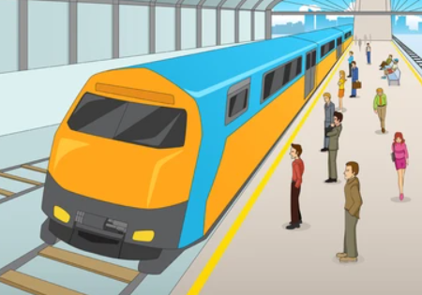


Sample data
Sample population?

Slide 10
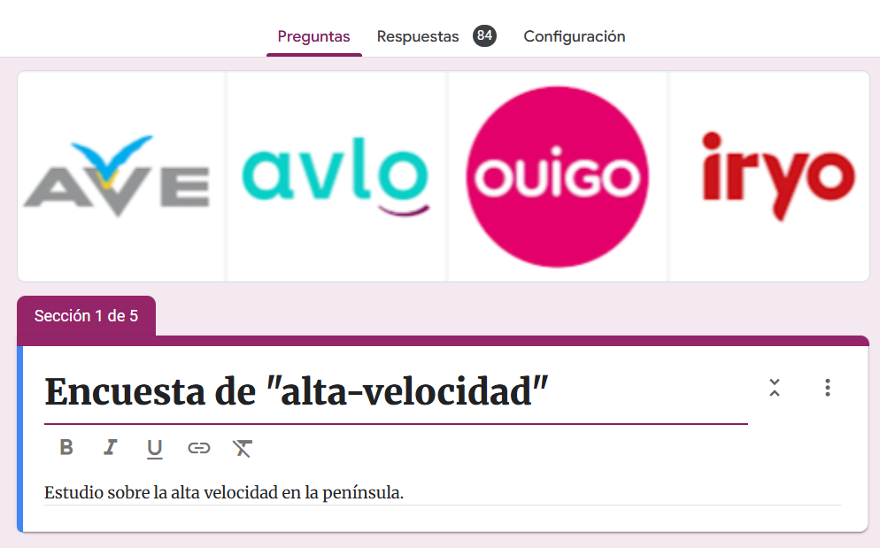
Data Sample for people’s perception
https://docs.google.com/forms/d/170FqGvLQ7BOMgYFp2rsAl7O6BRtHd7yeRdY2qebinjg/edit
Demographic data
High speed usage
Operator preferences and perception
Important aspects and desired improvements

Slide 11
CONTENT
Introduction
Sample data
Sample analysis
Useful insights

Slide 12

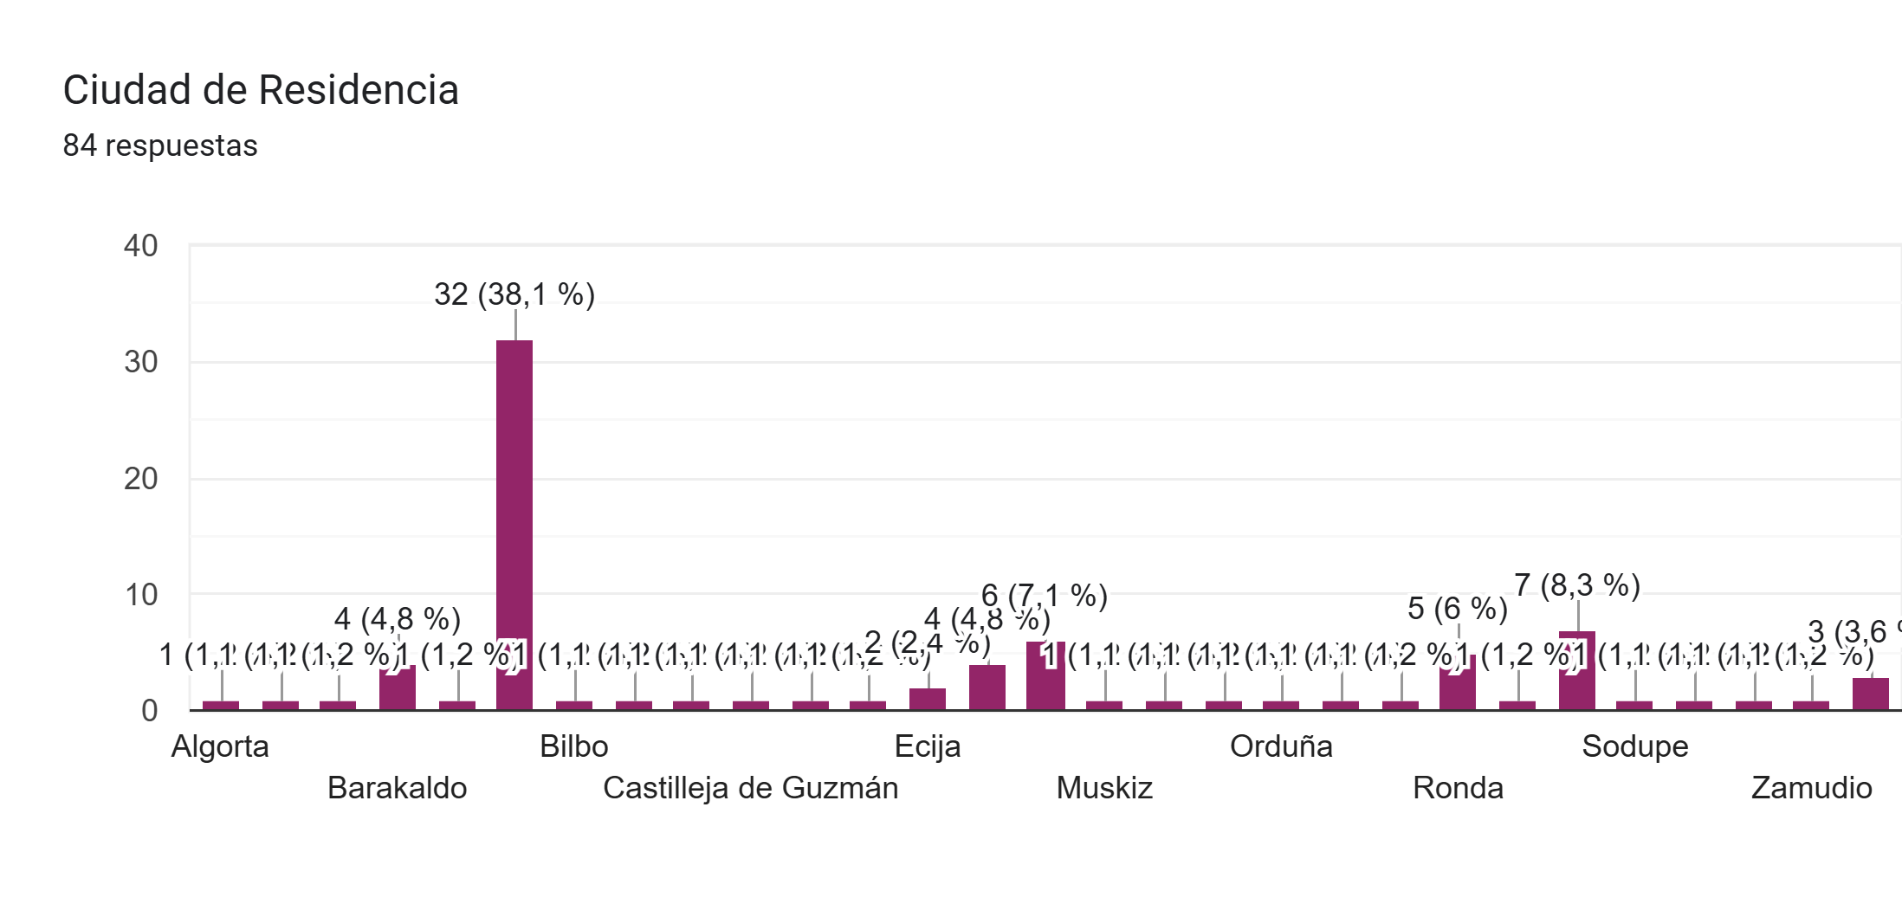
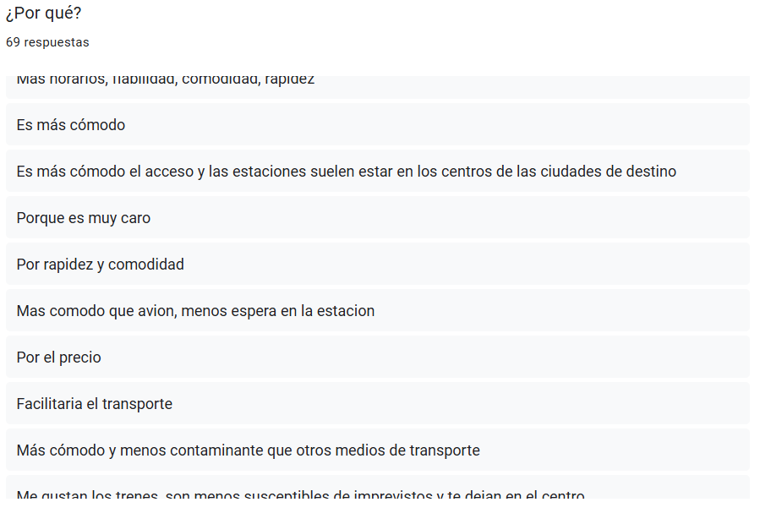
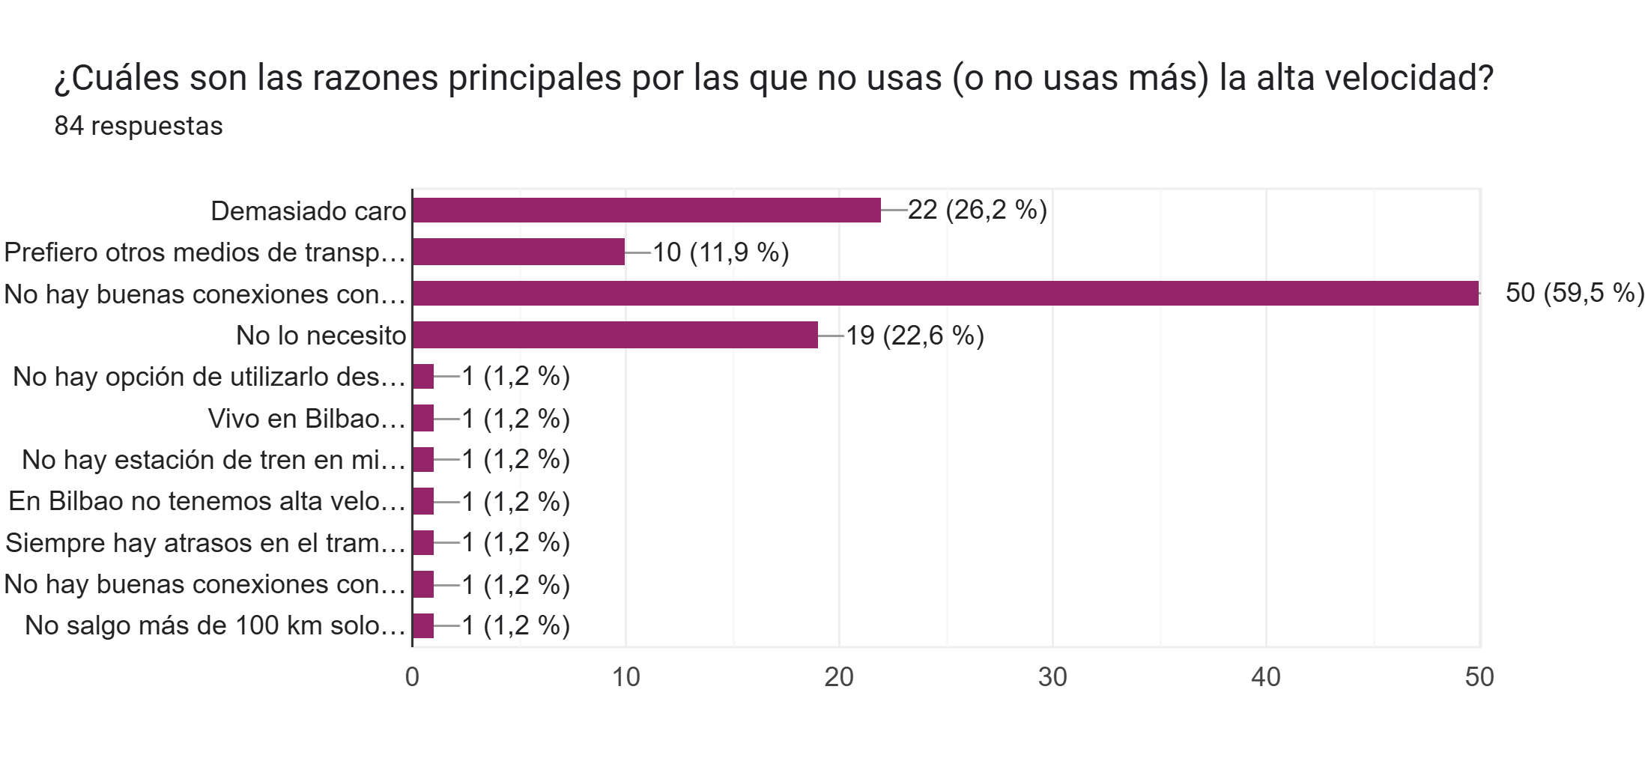
Sample analysis
Data cleaning

Slide 13

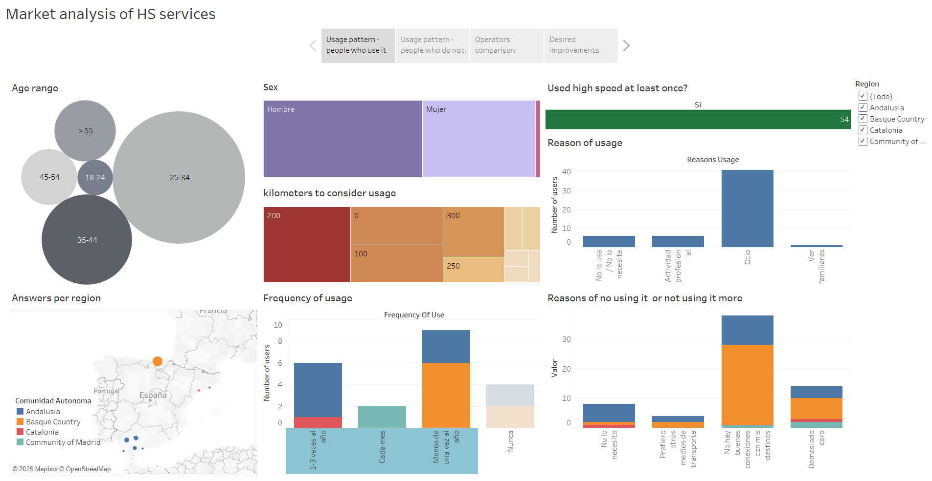
Sample analysis
1 . Main reason of taking the train is due to social reasons.
2. People do not take the train more because they find there are not good connections (either with origin or destiny).
3. The second main reason why people do not take it more it is because they find it very expensive.
Notes:
People that takes the train

Slide 14
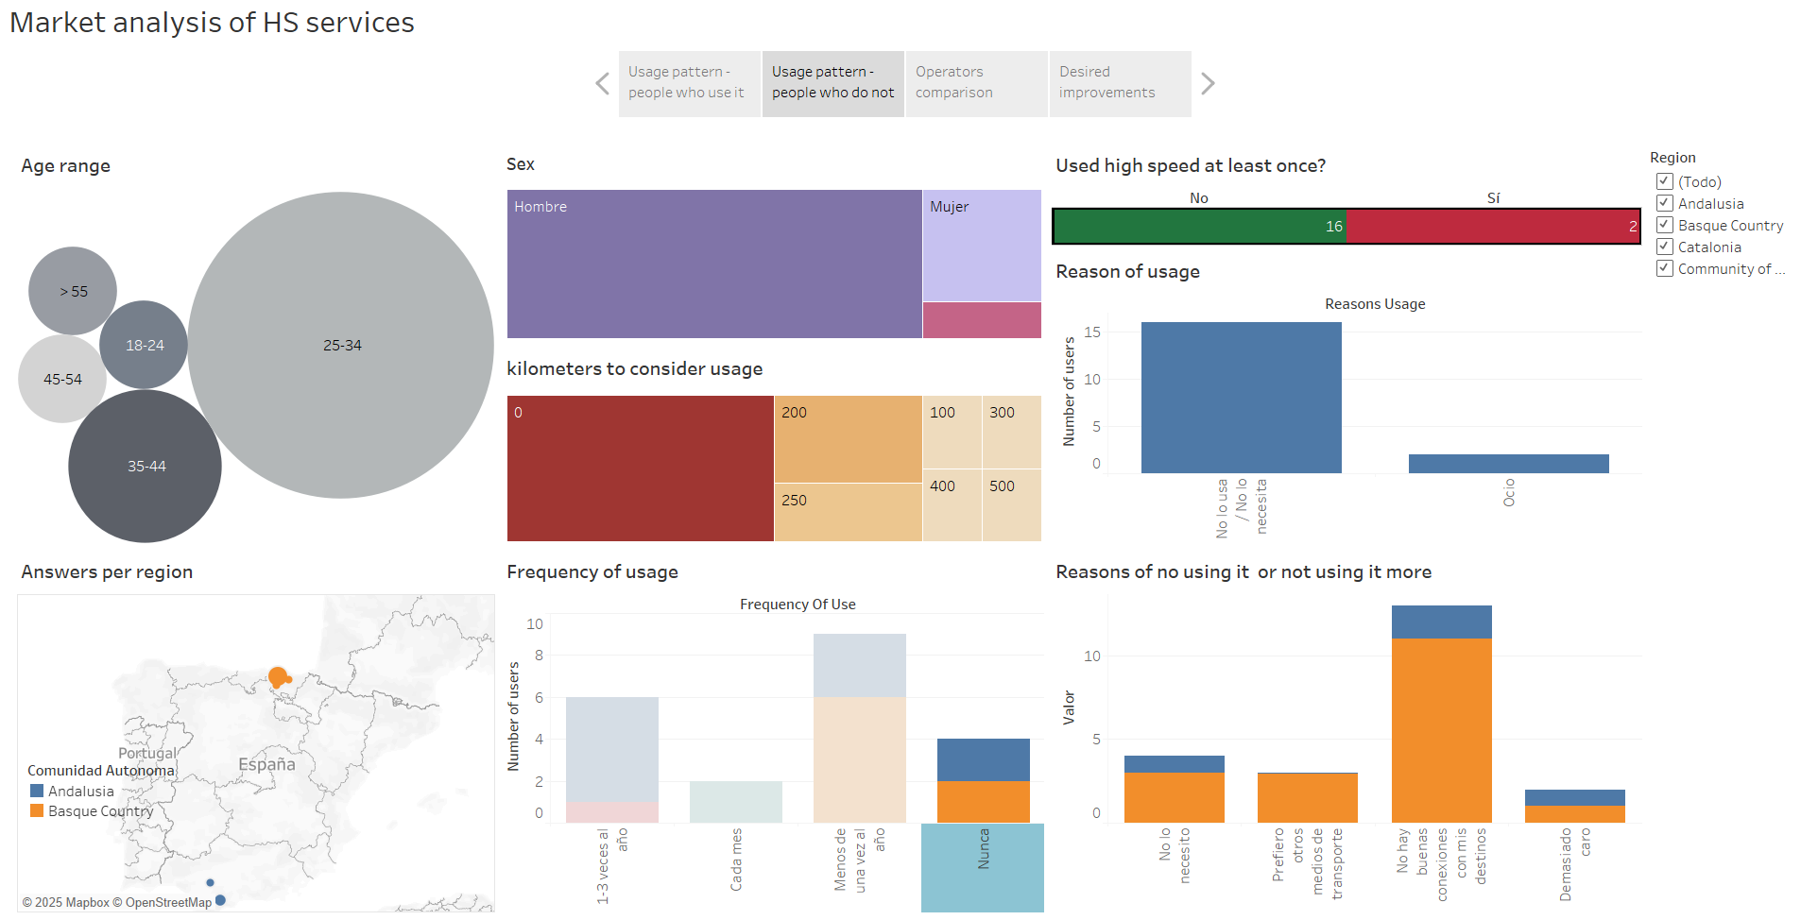
Sample analysis
Considering people that do not use the high speed trains, the main reason of no using it is because it does not have Good connections!
Notes:
People that takes the train

Slide 15
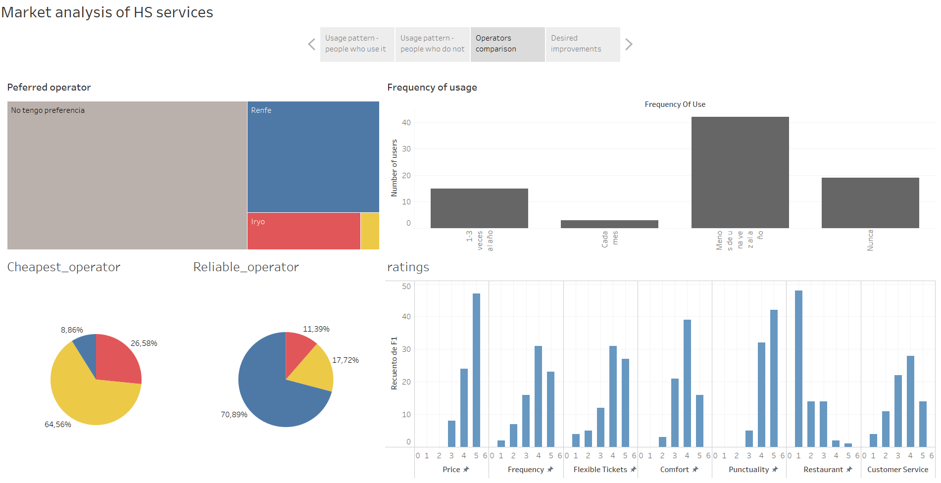
Sample analysis
1 . Most people do not have any preference, but Renfe is chosen as the favourite among the three operators, regardless of segmentation by frequency of use.
2. Ouigo is also seen as the cheapest company.
3. Most valuable features are Price and punctuality followed by tickets flexibility, frecuency and confort. Most of the people consider restaurant is not important.
Notes:
People that takes the train

Slide 16
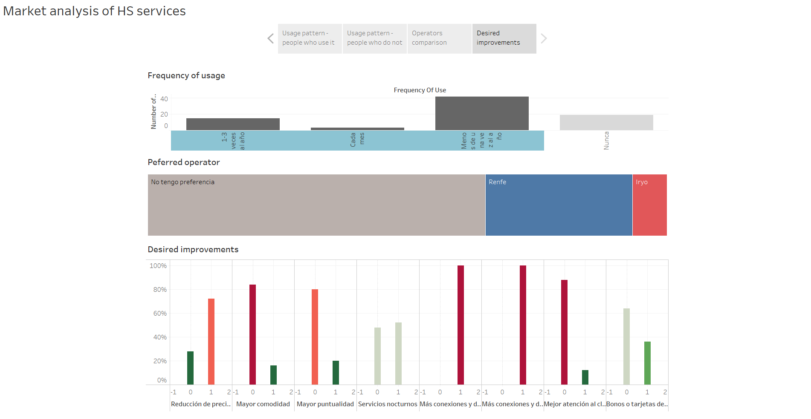
Sample analysis
1 . Most people want more national and international connections (specially the ones who takes the high-speed trians).
2. More than 70% wants an improvement on prices and are happy with current punctuality.
3. Night travels and frequent traveller cards are considerable but not high demand improvements.

Slide 17
CONTENT
Introduction
Sample data
Sample analysis
Useful insights

Slide 18

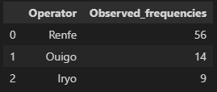
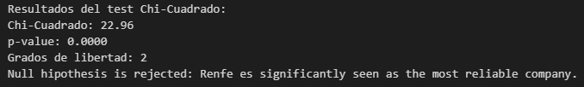

Useful insights
H0 = Renfe is not significantly considered as the most reliable operator.
H1 = Renfe is significantly considered as the most reliable operator.

Slide 19
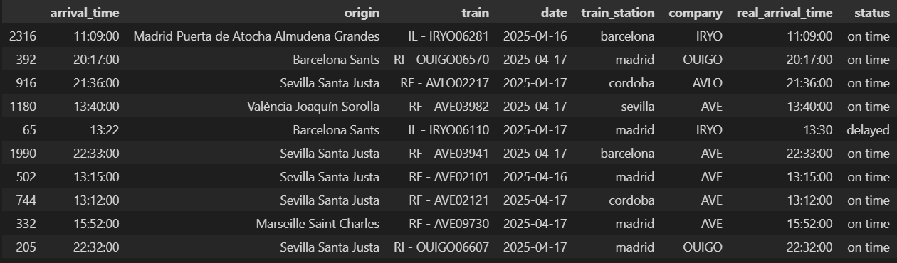
Useful insights
T-test
Notes:
There is no enough evidence to reject the null hipothesis that there is no significant difference of puntctuallity between Renfe and its competitors. It may be that Renfe is as reliable as the others or that others are more reliable, or that this is just a coincidence sample.

Slide 20
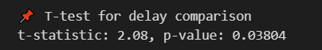
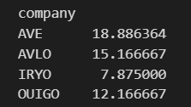
Useful insights
We can confirm with 95% of confidence level, that there are a significant difference between Renfe delays and other companies. Observed mean difference between Renfe delays and other companies is > 2 minutes.
Notes:
t-statistic = 2.08 → mean difference between delays of renfe and the other companies.
p-value = 0.03804 → 0.03804 < 0.05, we can reject null hypothesis with 95% confidence level.
Conclsion
We can say that there is a significant difference between RENFE delays (AVE+AVLO) and competitors delay (IRYO + OUIGO).

Slide 21
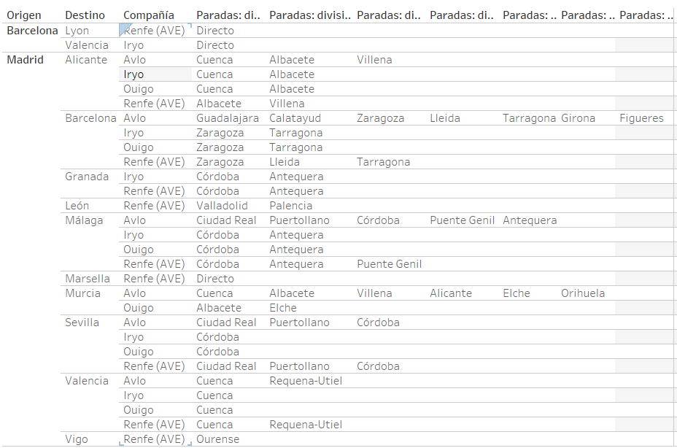
Useful insights
The influence of number of stops on the delay needs to be studied and re-do timetable if required.

Slide 22
Thank you. Questions?

